Slide 1
SENTIMENTAL ANALYSIS OF IMDB MOVIE REVIEWS
KEERTHI NIVASSIHINI THANGARAJ,
SHREE RAKSHA SIVASUBRAMANI
ADVISOR: DR. KHALID ABOALAYON
COURSE: MSDA3999 Summer 2023

Slide 2
Table of Contents
Objective
Introduction
Dataset
Proposed Architecture
Exploratory Data Analysis
NLP
Text Representation model
Machine Learning Algorithm
Result
Conclusion
Summary
Comparison
Time Chart
Professional Development
Reference and Acknowledgement

Slide 3
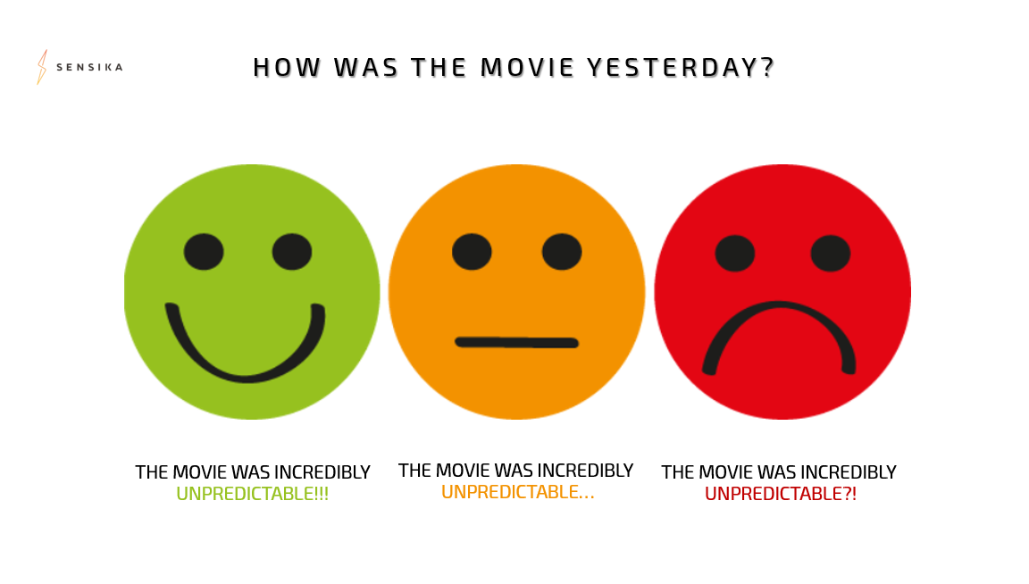
OBJECTIVE
The objective of our project is to classify the number of positive and negative reviews(documents) based on sentiments, using different classification models in Machine Learning.

Slide 4
INTRODUCTION
Generally an article published in a newspaper or magazine describes and evaluates the movie.
Reviews are typically written by journalists, giving their opinions on the movie.
Human mind can read and understand whether a review is positive but for movie studios it is difficult to hire employees to simply read and judge movie opinions. So here comes Data Mining and Machine Learning to reliably extract and classify the sentiment of unstructured movie reviews as Positive and Negative reviews.

Slide 5
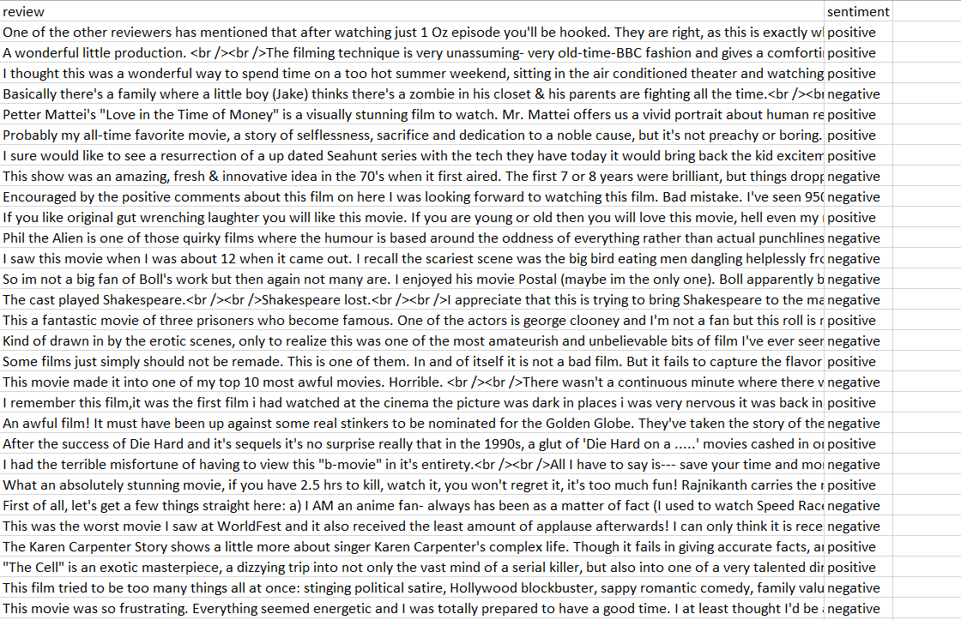
DATASET
A movie reviews dataset with texts in English language.The dataset is taken from Kaggle. It contains 3,20,000 movie reviews along with other useful data such as the name the genre and the date of the movie.We have taken the first 50,000 rows for our project.

Slide 6
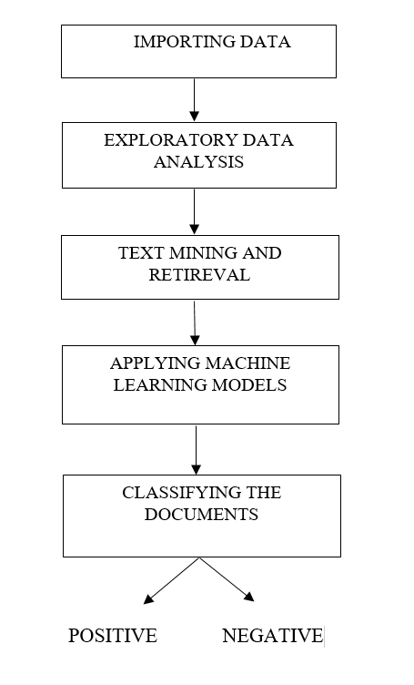
PROPOSED ARCHITECTURE
Loading the IMDB dataset
Exploring the data and the variables present to have better understanding of the data
Data Mining techniques like text mining and retrieval are implemented to clean the documents.
Implementing the Machine Learning models on the processed data.
Calculating the accuracy to check whether the reviews are Positive or Negative

Slide 7
EXPLORATORY DATA ANALYSIS
One key aspect of Exploratory Data Analysis (EDA) in sentiment analysis of IMDb movie reviews is to uncover patterns and gain initial insights by exploring and visualizing the dataset.
Summary of the Dataset.
Cleaning the Data
Handling Duplicate Rows
Column Selection
Sentiment Count

Slide 8
NATURAL LANGUAGE PROCESSING
Natural Language Processing, or NLP for short, is broadly defined as the automatic manipulation of natural language, like speech and text, by software.
Natural language processing has the ability to interrogate the data with natural language text or voice.

Slide 9

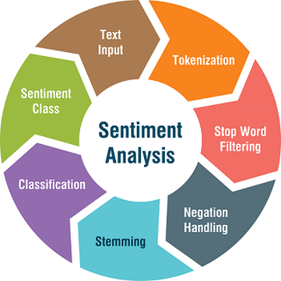
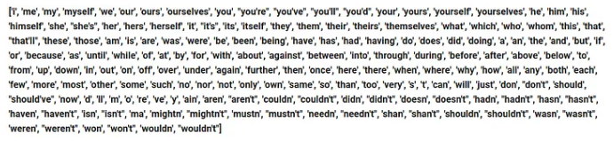
"I watched this movie, and I must say it was absolutely terrible. I didn't enjoy a single moment."
["I", "watched", "this", "movie", ",", "and", "I", "must", "say", "it", "was", "absolutely", "terrible", ".", "I", "didn't", "enjoy", "a", "single", "moment", "."]
Sentiment Class: Negative
The sentiment analysis model classifies the sentence as Negative due to the presence of the negative sentiment word "terrible" and the negation term "not" before "enjoy."
["watched", "movie", ",", "must", "say", "absolutely", "terrible", ".", "didn't", "enjoy", "single", "moment", "."]
[Positive, Negative, Neutral]
Positive: 0.2 Negative: 0.75 Neutral: 0.05
["watched", "movie", ",", "must", "say", "not", "absolutely", "good", ".", "not", "enjoy", "single", "moment", "."]
["watch", "movi", ",", "must", "say", "not", "absolut", "good", ".", "not", "enjoy", "singl", "moment", "."]

Slide 10
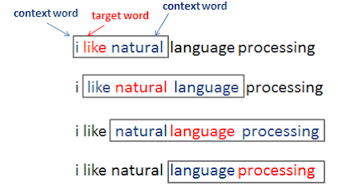

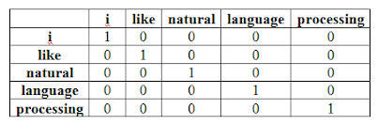
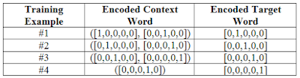
TEXT REPRESENTATION MODELS
BAG OF WORDS[BOW] | TITLE FOR TERM FREQUENCY - INVERSE DOCUMENT FREQUENCY [TF-IDF]
It is a simple NLP model that represents a text document as a collection of word frequencies, ignoring grammar and word order. | It is a more advanced NLP model that assigns importance scores to words based on their frequency in a document and resulting i n more meaningful text representations.
STEPS: BAG OF WORDS

Slide 11

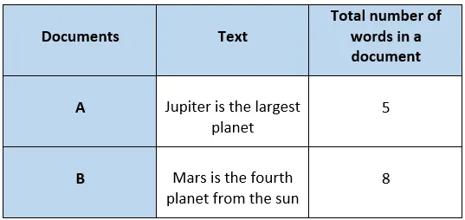
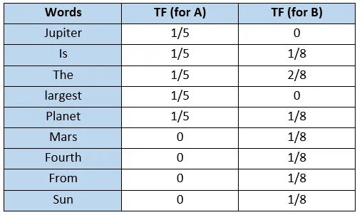

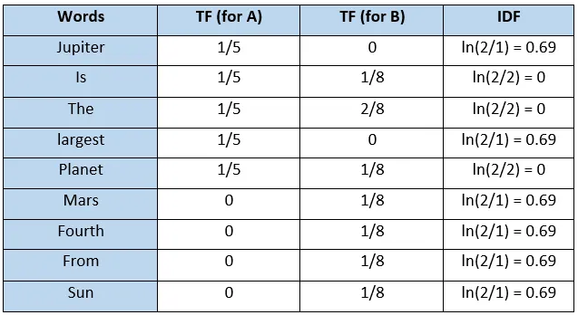
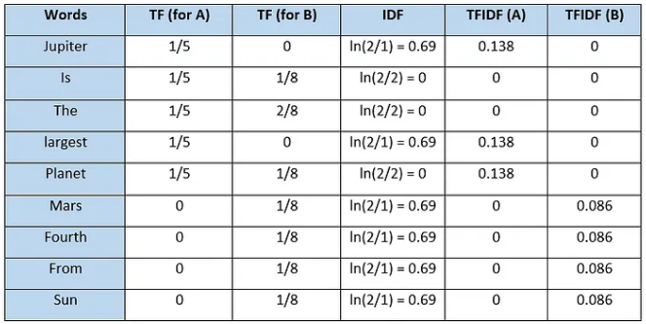
TEXT REPRESENTATION MODELS
STEPS: TITLE FOR TERM FREQUENCY - INVERSE DOCUMENT FREQUENCY

Slide 12
MACHINE LEARNING ALGORITHM
LOGISTIC REGRESSION
A statistical algorithm used for binary classification, predicting the probability of an outcome belonging to one of two classes.
It models the probability of a review belonging to a specific sentiment class using a logistic function, making it a foundational method for discerning sentiments expressed in movie reviews.
NAIVE BAYES
Probabilistic classifier using feature independence.
Assumes feature independence; suits text classification.
SUPPORT VECTOR MACHINE
Maximizes margin, uses kernel for non-linearity.
Balances classification with margin optimization.

Slide 13
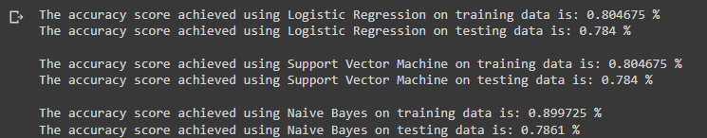
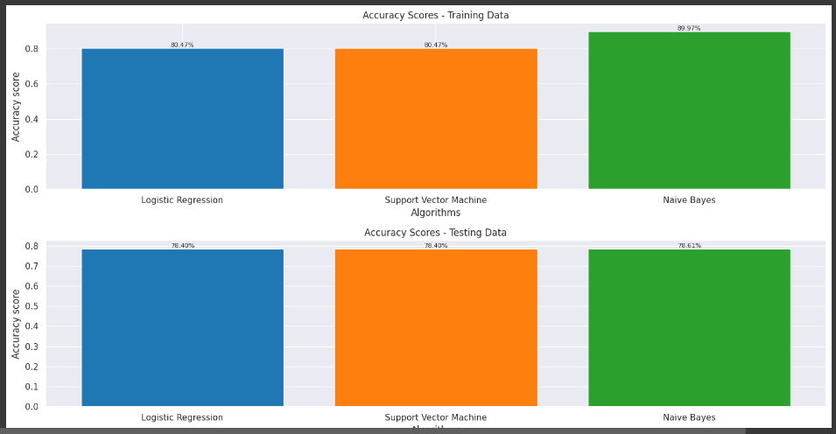
RESULT

Slide 14
CONCLUSION
Naive Bayes achieved the highest accuracy among the three algorithms (LR, SVM, and NB) in the sentiment analysis task.
Efficiency and speed favored Naive Bayes, making it suitable for real-time or large-scale sentiment analysis tasks.
The choice of dataset and feature engineering played a significant role in determining Naive Bayes' superior performance, highlighting the importance of careful data preprocessing and feature selection.

Slide 15
SUMMARY
Objective: Classify movie reviews using ML techniques.
EDA: Insights via sentiment distribution visualization.
NLP Preprocessing: Text data cleaning and preparation.
Algorithms: Naive Bayes, Logistic Regression, SVM.
Naive Bayes: Achieved highest accuracy.
Efficiency and Speed: Naive Bayes advantage.
Feature Engineering: Key to model success.

Slide 16
COMPARISON
SENTIMENTAL ANALYSIS OF IMDB MOVIE REVIEW | RESEARCH PAPER - Performance Analysis of Different Neural Networks for Sentiment Analysis on IMDb Movie Reviews
ALGORITHM: LR, SVM, NB | ALGORITHM: CNN, LSTM.
NLP: BOW, TF-IDF | NLP
Naive Bayes | CNN
RESULT: 89.95% | RESULT: 82%

Slide 17
TIMELINE
TIMELINE | JUNE |  |  |  |  | JULY |  |  |  | AUGUST
 | W 1 | W 2 | W 3 | W 4 | W 5 | W 1 | W 2 | W 3 | W 4 | W 1 | W 2
PROJECT FINALIZATION
EXPLORATORY DATA ANALYSIS
DATA MINING AND RETIREVAL
APPLYING MACHINING LEARNING MODEL AND RESULT
REPORT, PPT, ADD ON MODULE AND RESEARCH PAPER
- Planned
- Completed
- Work in progress

Slide 18
PROFESSIONAL DEVELOPMENT
Team Collaboration: The capstone project enhanced our ability to collaborate effectively within a team, fostering communication and teamwork skills essential for professional interactions.
Project Management: Balancing tasks, meeting deadlines, and setting milestones during the capstone developed our project management proficiency, aiding in organized and efficient execution of tasks.
Problem Solving and Expertise: The project's challenges refined our problem-solving skills, while in-depth research and implementation deepened our understanding of the subject matter, contributing to our professional expertise.

Slide 19
REFERENCES & ACKNOWLEDGEMENTS
We are in immense pleasure to express our hearty thanks to our Project Advisor Prof. Khalid Aboalayon for providing valuable guidance and constant support throughout the course of our project and our beloved friends for their unwavering support, brainstorming sessions, and encouragement during challenging times.
Pang, B., Lee, L., & Vaithyanathan, S. (2002). Thumbs up?: Sentiment classification using machine learning techniques. Proceedings of the ACL-02 conference on Empirical methods in natural language processing, 79-86. https://www.aclweb.org/anthology/P02-1053/
Haque, M. R., Lima, S. A., & Zaman Mishu, S. (2019). Performance Analysis of Different Neural Networks for Sentiment Analysis on IMDb Movie Review. In Proceedings of the 3rd International Conference on Electrical, Computer and Telecommunication Engineering (pp. 1-6). Faculty of Electrical and Computer Engineering, Rajshahi University of Engineering & Technology, Bangladesh

Slide 20
THANK YOU

